Slide 1

Analytics in
Soccer
Jon Constant & Shashank Kala

Slide 2
What is Sports Analytics?
“Sports analytics is the processes that identify and acquire the knowledge and insight about potential players’ performances based on the use of a variety of data sources such as game data and individual player performance data. These advanced and sophisticated type of analytics should be able to extract valuable actionable insights for the coaches and managers to utilize.”
-Masoud Nikravesh

Slide 3
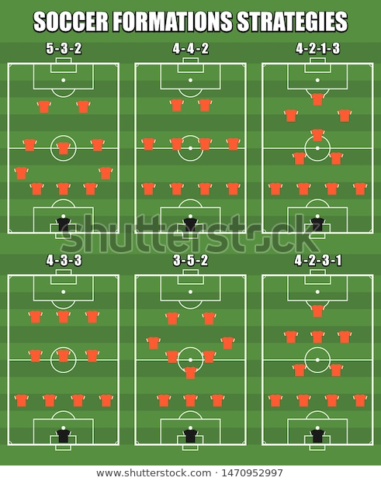
Who uses this information?
Managers of soccer clubs
Coaches
Players
Fans
Gamblers
News outlets
Other sports analysts

Slide 4
Types of analytics in soccer
Predictive analytics:
This form predicts the possibility of the outcome
Descriptive analytics:
This form analyzes the data in hand to come up with suggestions to increase the possibility even further
Without good data, analytics in soccer is basically useless

Slide 5
What does the data consist of?
Team Statistics
How many games has a team won or loss/if they are on a streak
Winning/losing percentage when playing home vs away
How many goals a team scores/lets up
How many assists a team gets/lets up
How many total points a team scores/lets up
How many shots a team is taking per game
Individual Statistics
How many goals a player has
How many assists a player has
How many minutes a player typically plays
How many miles a player covers per game
How many passes a player makes/misplaces per game

Slide 6
What does this data tell us?
This data helps managers of soccer clubs:
Optimize exercise programs
Put players on specific nutrition plans
Find out areas of the game that need to be worked on more in practice
Focus on which formations are the most successful
Key on how to counter opposing team's strengths
To Implement and execute game plans

Slide 7
From a management standpoint
Many professional sports teams function as businesses and use data analytics to:
Grow ticket sales
Strengthen marketing strategies
Increase product merchandise sales
Lessen operating costs
Partner with ‘21st Club’
“We exist to help soccer clubs achieve competitive edge and build sustainable success”
Aid clubs early recruit young talented players
Assist teams in offering salaries to players so they stick with the club

Slide 8
What makes soccer so hard to predict?
Even though there’s historical data on teams dating back thousands of years, why is it so hard to predict the winner of major championships?
Complexity of the game
Generally low scoring
Games end in ties
Includes the best athletes from around the world
Suspensions (Red Card)
Extra game time due to injuries
Referees are not perfect

Slide 9
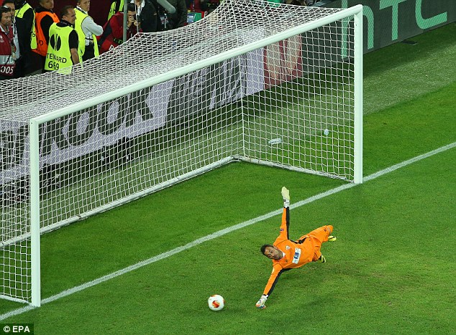
Goalkeepers
Key responsibilities:
Save shots
Communication
Organize the defense
Positive outlet passes
Parameters used to evaluate performance:
Shots saved
Fumbled or successfully grabbed
Goals given away
Passes on target
Free-kicks (short and long)
Fouls

Slide 10
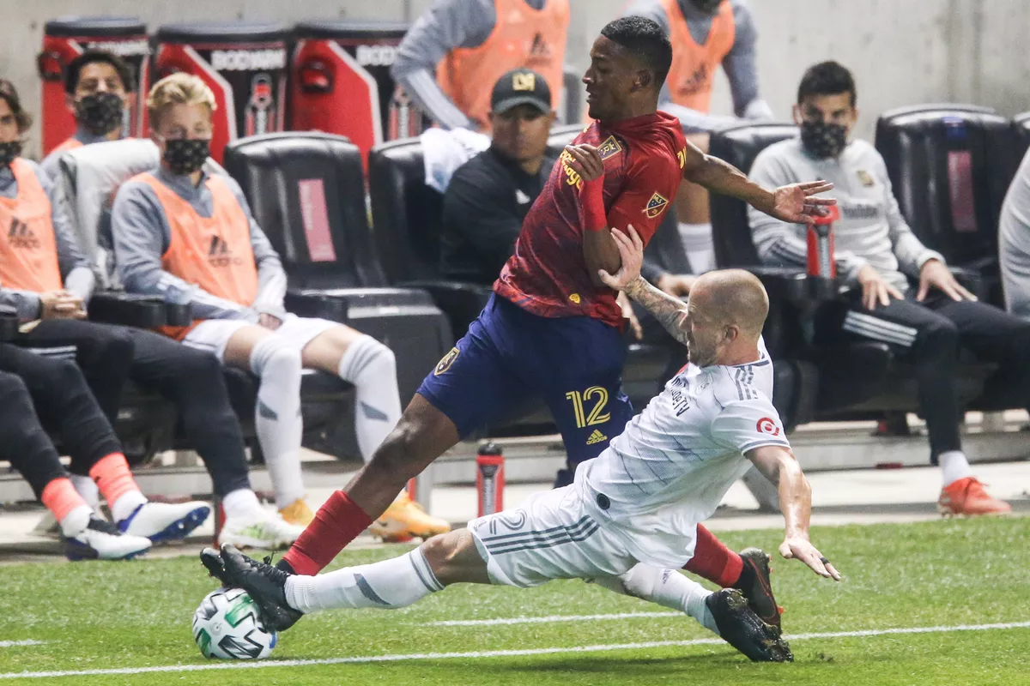
Defenders
Key Responsibilities:
Shot preventers
Transfer the ball to midfielders
Stealing the ball
Marking up opponents
Parameters used to evaluate performance:
Balls stolen/balls lost
Unsuccessful challenges
Got beaten
Fouls
Throw-ins
Goals/shots/shots on goal/shots off target
Passes on target

Slide 11
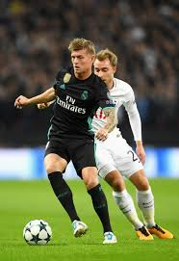
Midfielders
Key responsibilities:
Steal the ball and redirect it to the attackers
Take shots on goal
Accurate passes
Pressure the ball
Parameters used to evaluate performance:
Passes on target/corner kicks/cross-balls
Dribbles without losing it
Goals/shots/shots on goal/shots off target
Got beaten
Assists
Fouls
Takeaways/balls lost
Throw-ins

Slide 12
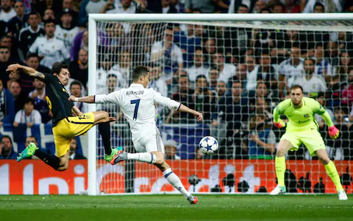
Attackers
Key responsibilities:
Scoring goals
Assisting teammates
Stealing the ball in the attacking region
Dribbling with poise
Parameters used to evaluate performance:
Goals/shots/shots on goal/shots off target
Dribbles without losing it
Assists
Fouls
Takeaways/balls lost
Passes on target and cross-balls

Slide 13
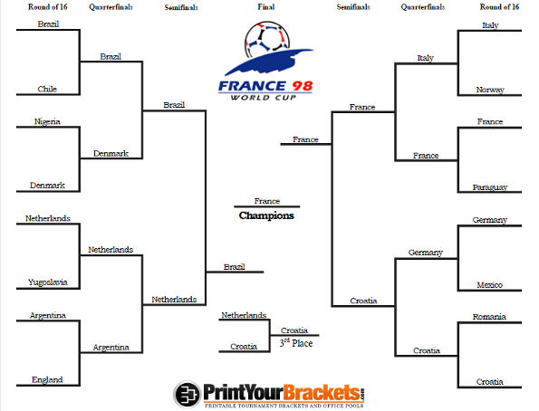
How teams in World Cup ‘98 were ranked
Ball possession
Passes
Receivings
Runs with the ball
Shots
Interceptions
Tackles
Duels

Slide 14
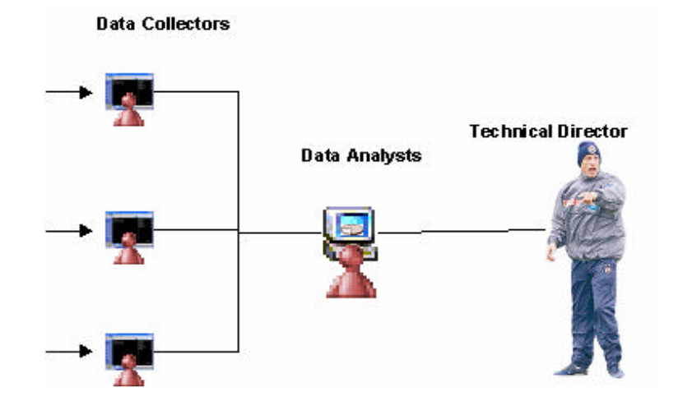
How the technical director uses the information from the games
Data is collected by data collectors using developed databases
The data is then transferred to the data analysts
The data analysts analyze the data according to the technical director’s needs
Helps the technical director to see the performances of soccer players
Assists the technical director to think clearly under high pressure
The technical director can decide on new tactics, formations or substitutions for changing the flow of game

Slide 15
Resources
https://www.experfy.com/blog/bigdata-cloud/moneyball-some-insights-to-soccer-analytics/
https://www.linkedin.com/company/21st-club/
https://www.researchgate.net/publication/228558144_Development_of_a_database_and_decision_support_system_for_performance_evaluation_of_soccer_players

